Slide 3

C BASIC
BINARY SEARCH TREE

Slide 4
CONTENT
Binary search tree
Inserting a key into a binary search tree (P.06.14.01)
Removing a key from a binary search tree (P.06.14.02)
Constructing a binary search tree from a sequence of pre-order traversal (P.06.14.03)

Slide 5
BINARY SEARCH TREE
Binary search tree
The key of a node is larger than all keys of the left subtree and smaller than all keys of the right subtree
Data structure of each node
20
10
30
struct Node {
key // key
leftChild // pointer to the left child node
rightChild // pointer to the right child node
}
2
15
25
40
12
22
28

Slide 6
BINARY SEARCH TREE
Find a key in a binary search tree
If k is equal to the key of the root node then return the pointer of the root node
If k is larger than the key of the root node then find k on the right subtree (recursion)
If k is smaller than the key of the root node then find k in the left subtree (recursion)
Find(r, k) {
if r = NULL then return NULL;
if r.key = k then return r;
if r.key < k then
return Find(r.rightChild, k);
else
return Find(r.leftChild, k);
}

Slide 7
BINARY SEARCH TREE
Insert a key into a binary search tree
If the tree is empty then create a new node with key k and return the pointer to the node
If k is equal to the key of the root node then return the pointer of the root node
If k is larger than the key of the root node then insert k into the right subtree (recursion)
If k is smaller than the key of the root node then insert k into the left subtree (recursion)
Insert(r, k) {
if r = NULL then return Node(k);
if r.key = k then return r;
if r.key < k then
r.rightChild = Insert(r.rightChild, k);
else
r.leftChild = Insert(r.leftChild, k);
return r;
}

Slide 8
BINARY SEARCH TREE
Remove a key from a binary search tree
If the tree is empty then return NULL
If k is larger than the key of the root node then remove k from the right subtree (recursion)
If k is smaller than the key of the root node then remove k from the left subtree (recursion)
If k is equal to the key of the root node
Find the node having the largest key in the left subtree or the node having the smallest key in the right subtree to replace the root node
Remove(r, k) {
if r = NULL then return NULL;
if r.key = k then
return RemoveRoot(r);
if r.key < k then
r.rightChild = Remove(r.rightChild, k);
else
r.leftChild = Remove(r.leftChild, k);
return r;
}

Slide 9
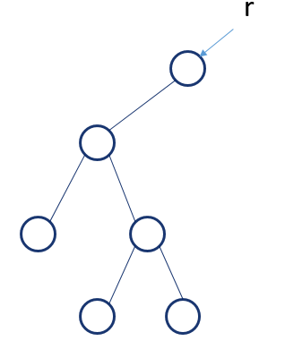
BINARY SEARCH TREE
Remove the root node of a binary search tree
If the root node does not have a right child node then return the pointer to the left child node
RemoveRoot(r) {
if r = NULL then return NULL;
tmp = r;
if r.rightChild = NULL then {
r = r.leftChild; free(tmp); return r;
}
p = r.rightChild; pp = r;
if p.leftChild = NULL then {
r.key = p.key; tmp = p; r.rightChild = p.rightChild;
free(tmp); return r;
}
while p.leftChild != NULL do { pp = p; p = p.leftChild; }
pp.leftChild = p.rightChild; r.key = p.key; free(p);
return r;
}

Slide 10
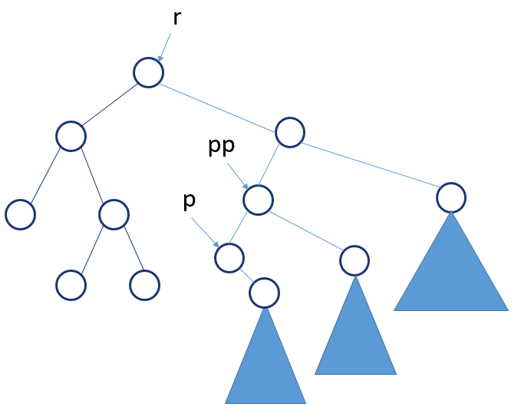
BINARY SEARCH TREE
Remove the root node from a binary search tree
If the root node has a right child node then find the node having the smallest key on the right subtree to replace
RemoveRoot(r) {
if r = NULL then return NULL;
tmp = r;
if r.rightChild = NULL then {
r = r.leftChild; free(tmp); return r;
}
p = r.rightChild; pp = r;
if p.leftChild = NULL then {
r.key = p.key; tmp = p; r.rightChild = p.rightChild;
free(tmp); return r;
}
while p.leftChild != NULL do { pp = p; p = p.leftChild; }
pp.leftChild = p.rightChild; r.key = p.key; free(p);
return r;
}

Slide 11
INSERTING A KEY TO A BINARY SEARCH TREE (P.06.14.01)
Given a binary search tree T (starting from the empty tree). Perform a series of operations to insert keys into T and traverse with preorder and postorder in T.
insert k: insert a node with key k into T (if there is no node with key k)
preorder: print a sequence of keys visiting with preorder traversal in T (SPACE separator)
postorder: print a sequence of keys visiting with postorder traversal in T (SPACE separator)
Data
Each line with information about an operation of one of the above three types
Input data ends with a line “#”
Result
Each line is the result of a preorder or postorder from input data
stdin | stdout
insert 5 insert 9 insert 2 insert 1 preorder insert 8 insert 5 insert 3 postorder # | 5 2 1 9 1 3 2 8 9 5

Slide 12
INSERTING A KEY TO A BINARY SEARCH TREE - PSEUDOCODE
Algorithm
At each step, search information from input and perform the corresponding operation.
Run() {
root = NULL;
while true do {
cmd = read a string from stdin;
if cmd = “#” then break;
if cmd = “insert” then {
k = read an integer from stdin;
root = Insert(root, k);
}else if cmd = “preorder” then
PreOrder(root);
else if cmd = “postorder” then
PostOrder(root);
}
}

Slide 13
INSERTING A KEY TO A BINARY SEARCH TREE – COMPLETE CODE
#include <stdio.h>
#include <stdlib.h>
#include <string.h>
typedef struct Node{
int key;
struct Node* leftChild;
struct Node* rightChild;
}Node;
Node* root;
Node* makeNode(int k){
Node* p = (Node*)malloc(sizeof(Node));
p->key = k; p->leftChild = NULL;
p->rightChild = NULL;
return p;
}
Node* insert(Node* r, int k){
if(r == NULL) r = makeNode(k);
else if(r->key > k)
r->leftChild = insert(r->leftChild, k);
else if(r->key < k)
r->rightChild = insert(r->rightChild,k);
return r;
}

Slide 14
INSERTING A KEY TO A BINARY SEARCH TREE – COMPLETE CODE
void preOrder(Node* r){
if(r == NULL) return;
printf("%d ",r->key);
preOrder(r->leftChild);
preOrder(r->rightChild);
}
void postOrder(Node*r){
if(r == NULL) return;
postOrder(r->leftChild);
postOrder(r->rightChild);
printf("%d ",r->key);
}
int main(){
root = NULL;
while(1){
char cmd[256];
scanf("%s",cmd);
if(strcmp(cmd,"#") == 0) break;
else if(strcmp(cmd,"insert") == 0){
int k; scanf("%d",&k); root = insert(root,k);
}else if(strcmp(cmd,"preorder")==0){
preOrder(root); printf("\n");
}else if(strcmp(cmd,"postorder")==0){
postOrder(root); printf("\n");
}
}
return 0;
}

Slide 15
REMOVING A KEY FROM A BINARY SEARCH TREE (P.06.14.02)
Given a binary search tree T (starting from the empty tree). Perform a series of operations to insert keys, remove keys, and traverse with preorder and postorder in T
insert k: insert a node with key k into T (if there is no node with key k)
remove k: remove key k from T
preorder: print a sequence of keys visiting with preorder traversal in T (SPACE separator)
postorder: print a sequence of keys visiting with postorder traversal in T (SPACE separator)
Data
Each line with information about an operation of one of the above four types
Input data ends with a line “#”
Result
Each line is the result of a preorder or postorder from input data
stdin | stdout
insert 5 insert 9 insert 2 insert 1 preorder insert 8 insert 5 insert 3 postorder # | 5 2 1 9 1 3 2 8 9 5

Slide 16
REMOVING A KEY FROM A BINARY SEARCH TREE - PSEUDOCODE
Run() {
root = NULL;
while true do {
cmd = read a string from stdin;
if cmd = “#” then break;
if cmd = “insert” then {
k = read an integer from stdin;
root = Insert(root, k);
} else if cmd = “remove” then {
k = read an integer from stdin;
root = Remove(root,k);
}else if cmd = “preorder” then
PreOrder(root);
else if cmd = “postorder” then
PostOrder(root);
}
}
Algorithm
At each step, search information from input and perform the corresponding operation.

Slide 17
REMOVING A KEY FROM A BINARY SEARCH TREE – COMPLETE CODE
#include <stdio.h>
#include <stdlib.h>
#include <string.h>
typedef struct Node{
int key;
struct Node* leftChild;
struct Node* rightChild;
}Node;
Node* root;
Node* makeNode(int k){
Node* p = (Node*)malloc(sizeof(Node));
p->key = k; p->leftChild = NULL;
p->rightChild = NULL;
return p;
}
Node* insert(Node* r, int k){
if(r == NULL) r = makeNode(k);
else if(r->key > k)
r->leftChild = insert(r->leftChild, k);
else if(r->key < k)
r->rightChild = insert(r->rightChild,k);
return r;
}

Slide 18
REMOVING A KEY FROM A BINARY SEARCH TREE – COMPLETE CODE
Node* removeRoot(Node* r){
if(r == NULL) return NULL;
if(r->rightChild == NULL){
Node* tmp = r;
r = r->leftChild; free(tmp); return r;
}
Node* p = r->rightChild; Node* pp = r;
if(p->leftChild == NULL){
r->key = p->key; Node* tmp = p;
r->rightChild = p->rightChild;
free(tmp); return r;
}
while(p->leftChild != NULL){ pp = p; p = p->leftChild; }
pp->leftChild = p->rightChild; r->key = p->key; free(p);
return r;
}
Node* removeNode(Node* r, int k){
if(r == NULL) return NULL;
if(r->key == k)
return removeRoot(r);
else if(r->key < k)
r->rightChild = removeNode(r->rightChild,k);
else
r->leftChild = removeNode(r->leftChild,k);
return r;
}

Slide 19
REMOVING A KEY FROM A BINARY SEARCH TREE – COMPLETE CODE
void preOrder(Node* r){
if(r == NULL) return;
printf("%d ",r->key);
preOrder(r->leftChild);
preOrder(r->rightChild);
}
void postOrder(Node*r){
if(r == NULL) return;
postOrder(r->leftChild);
postOrder(r->rightChild);
printf("%d ",r->key);
}
int main(){
root = NULL;
while(1){
char cmd[256];
scanf("%s",cmd);
if(strcmp(cmd,"#") == 0) break;
else if(strcmp(cmd,"insert") == 0){
int k; scanf("%d",&k); root = insert(root,k);
}else if(strcmp(cmd,"remove")==0){
int k; scanf("%d",&k); root = removeNode(root,k);
}else if(strcmp(cmd,"preorder")==0){ preOrder(root); printf("\n");}
else if(strcmp(cmd,"postorder")==0){ postOrder(root); printf("\n");}
}
return 0;
}

Slide 20
CONSTRUCTING A BINARY SEARCH TREE FROM A SEQUENCE OF PREORDER TRAVERSAL (P.06.14.03)
Given a binary search tree T, each node has a key as an positive integer. Given a sequence of the keys with preorder traversal in T: k₁, k₂, . . ., k_{n} . Find the sequence of keys with postorder traversal in T.
Data
Line 1: An positive integer n (1 <= n <= 50000)
Line 2: A sequence of keys k₁, k₂, . . ., k_{n} (1 <= k_{i} <= 1000000)
Result
Write out a sequence of keys with postorder traversal in T or NULL if T is empty.
stdin | stdout
11 10 5 2 3 8 7 9 20 15 18 40 | 3 2 7 9 8 5 18 15 40 20 10
stdin | stdout
11 10 5 2 3 8 7 9 20 15 18 4 | NULL

Slide 21
CONSTRUCTING A BINARY SEARCH TREE FROM A SEQUENCE OF PREORDER TRAVERSAL – PSEUDOCODE
Constructing a binary search T from a sequence of keys with preorder traversal.
The root node has key k₁
Find index i such that k₁ is larger k₂, k₃, . . ., k_{i} and k₁ is smaller than k_{i+1}, k_{i+2}, . . ., k_{n}.
If there is no i then T does not exist
Otherwise, T T is constructed by the rules:
Create a tree with the root node k₁
Create a left subtree with a sequence of keys k₂, k₃, . . ., k_{i} and a right subtree with a sequence of keys k_{i+1}, k_{i+2}, . . ., k_{n}.
BuildBST(k[1..n], L, R){
if L > R then return NULL;
r = Node(k[L]); // tạo nút gốc
i = L + 1;
while i <= R and a[i] < a[L] do { i = i + 1; }
i = i – 1;
for j = i+1 to R do
if a[j] < a[L] then {
ok = False; // biến tổng thể
return NULL; // T không tồn tại
}
r.leftChild = BuildBST(k[1..n], 2, i);
r.rightChild = BuildBST(k[1..n], i+1, R);
return r;
}

Slide 22
CONSTRUCTING A BINARY SEARCH TREE FROM A SEQUENCE OF PREORDER TRAVERSAL – COMPLETE CODE
#include <stdio.h>
#include <stdlib.h>
#define N 100001
int n;
int a[N];
int ok = 1;
typedef struct Node{
int id;
struct Node* leftChild;
struct Node* rightChild;
}Node;
Node* makeNode(int id){
Node* p = (Node*)malloc(sizeof(Node));
p->id = id; p->leftChild = NULL;
p->rightChild = NULL; return p;
}
Node* build(int start, int end){
if(start > end) return NULL;
if(start == end){ return makeNode(a[start]); }
Node* r = makeNode(a[start]);
int i = start + 1;
while(i <= end && a[i] < a[start]) i++;
for(int j = i; j <= end; j++)
if(a[j] < a[start]){ ok = 0; break; }
r->leftChild = build(start+1,i-1);
r->rightChild = build(i,end);
return r;
}

Slide 23
CONSTRUCTING A BINARY SEARCH TREE FROM A SEQUENCE OF PREORDER TRAVERSAL – COMPLETE CODE
void postOrder(Node* r){
if(r == NULL) return;
postOrder(r->leftChild);
postOrder(r->rightChild);
printf("%d ",r->id);
}
int main(){
scanf("%d",&n);
for(int i = 1; i <= n; i++) scanf("%d",&a[i]);
ok = 1;
Node* root = build(1,n);
if(ok == 0){
printf("NULL"); return;
}
postOrder(root); printf("\n");
return 0;
}

Slide 24
THANK YOU !

